Slide 1

SafeWave
Vaishnavi Sawant - 24107038 Preshita Patil - 24107126 Sneha Shinde – 24107069 Hastaksh Reddy - 24107134
Project Guide
Ms.Ashwini Parkar

Slide 2
Primary SDG Mapped:
SDG 3: Good Health and Well-being
“Ensure healthy lives and promote well-being for all at all ages."
→This app directly contributes to personal safety and well-being. In emergencies (accidents, health crises, unsafe situations), the ability to instantly share your location with family/friends can be life-saving. This aligns with promoting well-being for all ages — students, men, women, elderly.

Slide 3
Secondary SDG: SDG 11 – Sustainable Cities and Communities
"Make cities and human settlements inclusive, safe, resilient, and sustainable.“
→The app contributes to making communities safer by enabling quick emergency response through real-time location sharing. It supports urban safety infrastructure at a personal/community level, which is a core component of SDG 11.

Slide 4
1. Introduction
Problem Identified :
SafeWave is a mobile safety application developed using Java in Android Studio.
It helps users quickly send emergency alerts to saved contacts during dangerous situations.
Solution Proposed :
The SafeWave app allows users to save emergency contacts. With one click on the SOS button, an alert message is sent to all saved contacts.

Slide 5
2. Objectives
To develop a mobile safety application that helps users send emergency alerts quickly.
To provide a simple SOS feature that sends alert messages to saved contacts during dangerous situations.
3. To provide accurate location Data.

Slide 6
3. Scope
Can be used by students, parents, and individuals to send emergency alerts quickly.
Can be applied in situations where a person needs to inform others about danger or seek immediate help.

Slide 7
4. Feature /Functionality
Save Emergency Contacts
Users can save important contact numbers in the application. These contacts will receive alerts during emergency situations.
SOS Alert Message
The SOS button sends an emergency alert message to all saved contacts.
It helps users quickly inform others when they are in danger.
View and Manage Contacts
Users can view all saved contacts in the application. Contacts can also be deleted if they are no longer needed.

Slide 8
5. Outcome of Project
User can save emergency contact numbers in the application.
User can send an SOS alert message to all saved contacts with one click.
User can view and manage saved contacts easily within the app.
The application will help users quickly inform others during emergency situations.

Slide 9
6. Technology Stack
Frontend (GUI): XML for designing the user interface.
Backend / Programming: Java for application logic and functionality.
Development Tool: Android Studio for building and testing the mobile application.

Slide 10
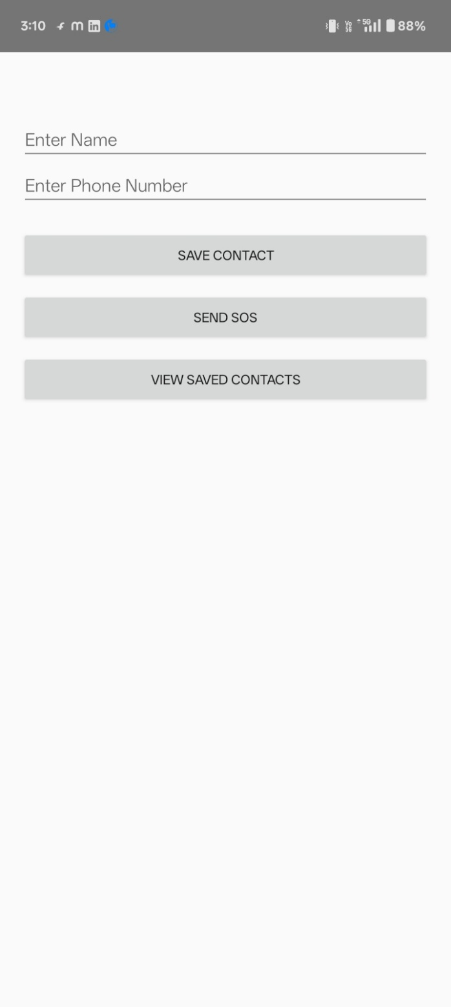
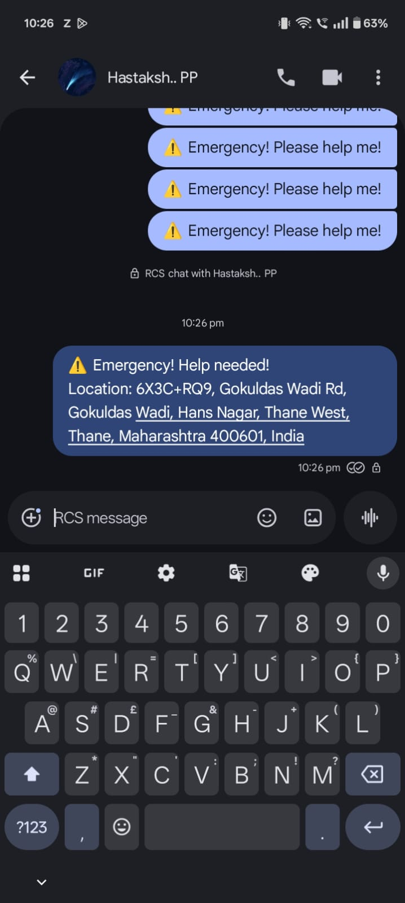

Slide 11
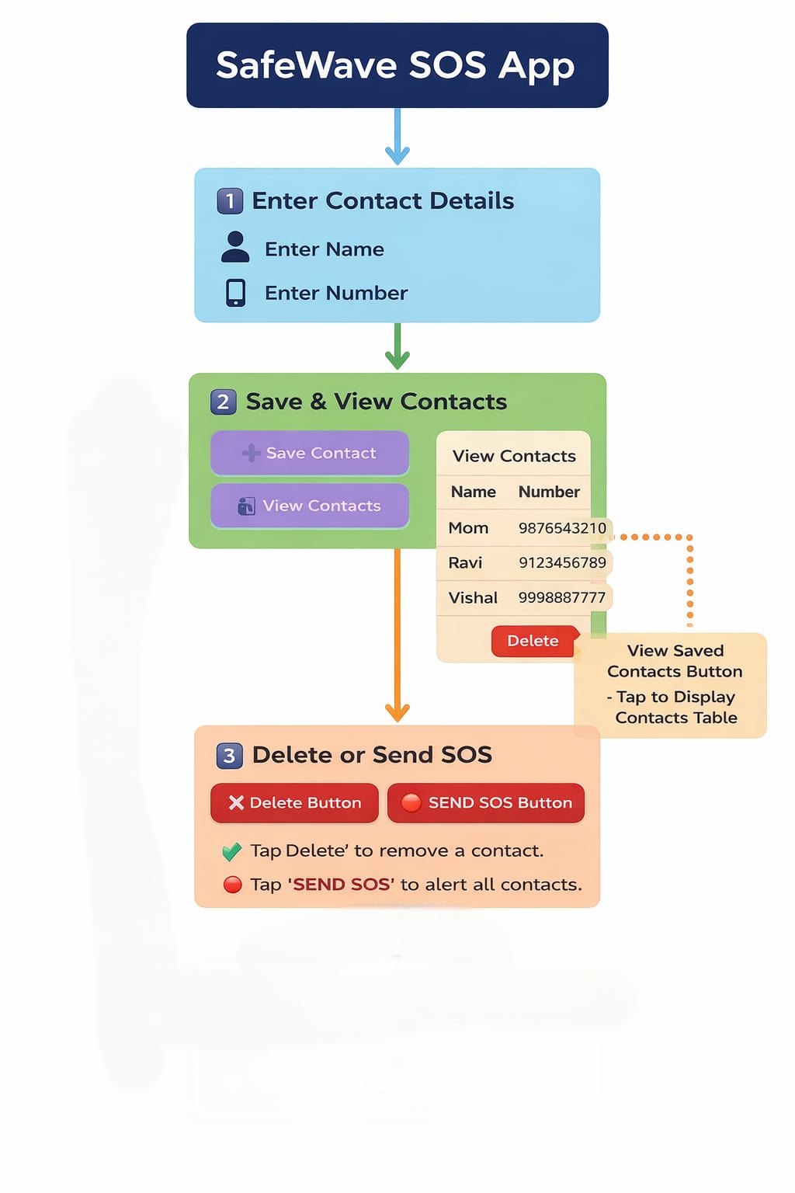
Block Diagram:

Slide 12
Thank You...!!

